Slide 1
Datafest 2016
InterCity Pricing Optimization
By the Flying Dutchmen
Yanzhe Liu, Quanjie Geng, Jing Li
Notes:
Our goal is to maximize revenue for each specific event. We optimize ticket prices with respect to the event’s popularity.
For events that are popular, we could increase its unit price by a percentage to increase the total revenue without losing the demand.
For events that are not as popular, we could decrease its unit price by a little bit to boost ticket sale.

Slide 2
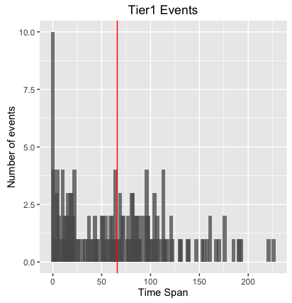
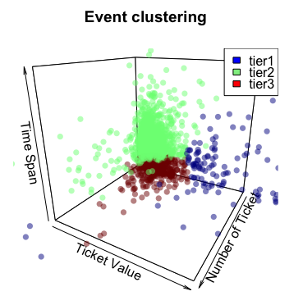
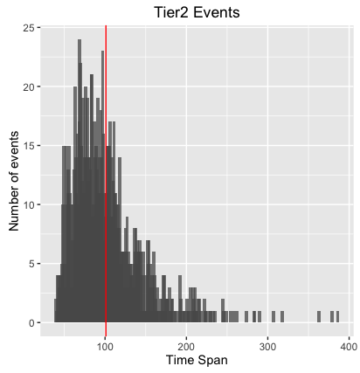
Event clustered into three tiers
Time Span = Last Transaction Date of 90% Tickets Sold - Ticket Onsale Date
Ticket Value = Most popular price level
Notes:
So how do we quantify popularity? We define the term time span, to specify the time it takes for an event to sell out 90% of its tickets.
The smaller the time span is, the more popular the event is, the more demand the event have.
Using time span, ticket value, and number of tickets sold, we categorize the events into three tiers using hierarchical clustering with euclidean distance as measurement.
The two figures on the right shows a significant difference between tier1 and tier2 events in terms of time span. Other indicators include event categories, delivery methods and etc. These facts supports our event segmentation. This segmentation will play an important role when we calculate our price adjustment.
We will come back to this in the next slide.

Slide 3
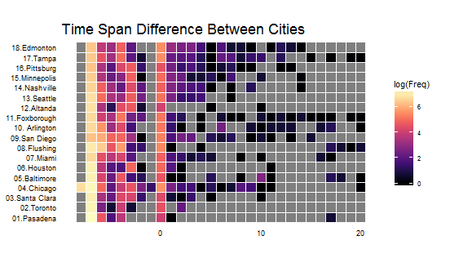
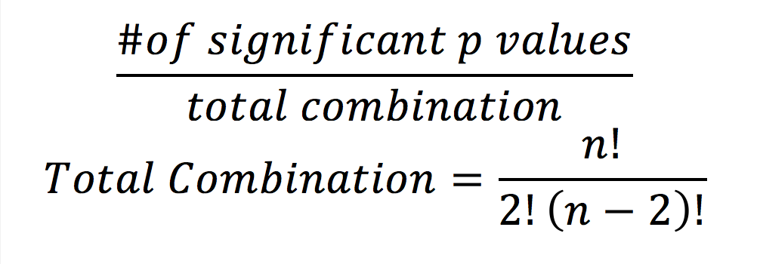
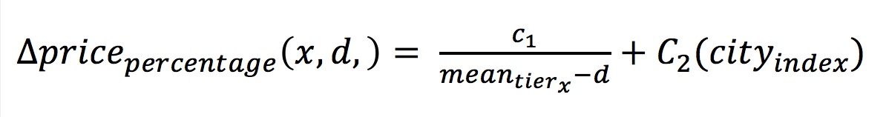
How do we know that location matters in pricing?
What the algorithm looks like:
What statistics tells us:
Quantify popularity of an event by time span
26% of the top 250 most frequent events has the significance ratio larger than 0.5
Extract the top 250 most frequent events and calculate their time spans
Use ANOVA test for the time span differences between cities for each event
Calculate significance ratio by TukeyHSD test:
Significance ratio >0.5
Popularity of a certain event does differ based on location
Notes:
第一页的内容更重要的是放在公式里看，你把第一页都讲完，我在第二页在讲我们怎么用第一的内容

